Slide 1
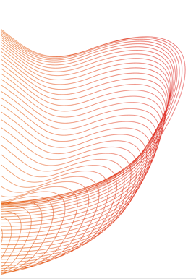
Leveraging Deep Learning and Large Language Models to Identify Clinical Exposure Changes Due to Extrinsic and Intrinsic Factors
Launch and Learn webinar
Subtitle: A Comparative Study
Hamed Meshkin
January 17, 2025

Slide 2
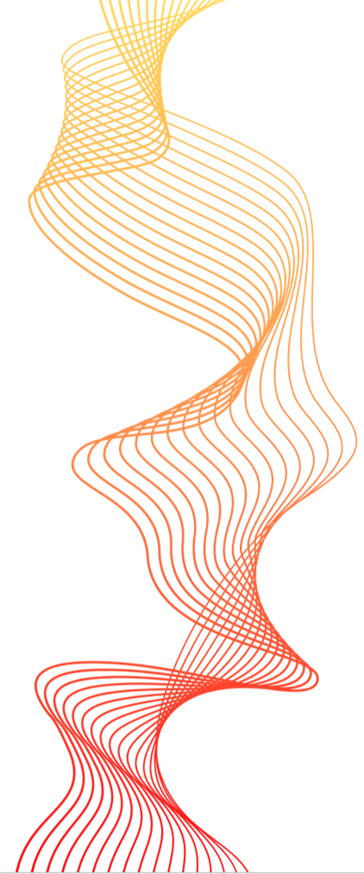
Outline
Prior Study (Fine-tuning LLM to extract clin pharm information with custom training dataset)
Objective
Background and Motivation (Extracting drug-drug Interaction + object and precipitant drug)
BioBert Directional DDI model
Result and Performance
Second Study (Directly Using LLM to extract clin pharm information with Few/zero training)
Objective
Background (Extracting drug-drug Interaction + patients' intrinsic factors)
LLM In-context learning (Few and Zero-shot learning)
Model Evaluation
Summary

Slide 3
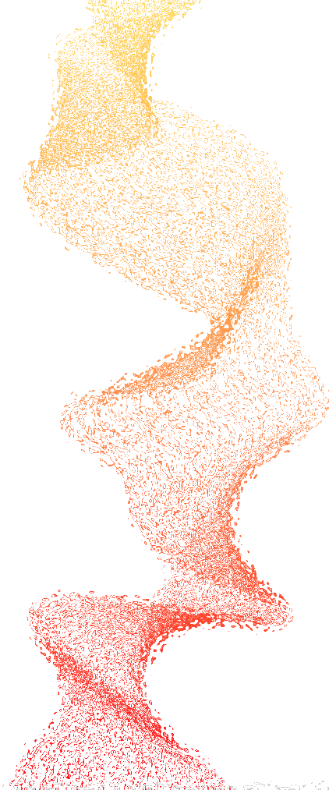
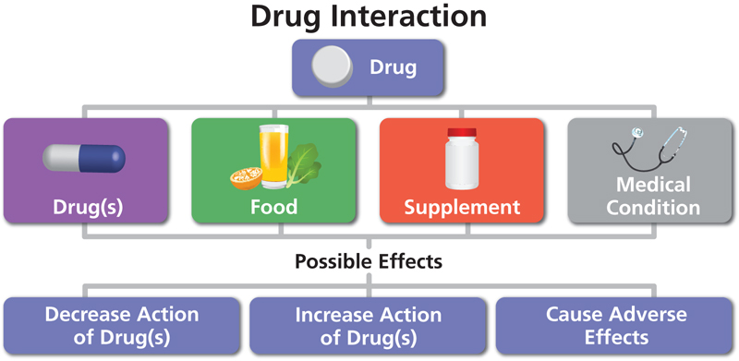
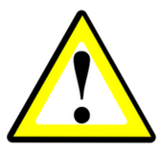
1. Goal (prior): Fine-tuning LLM to extract clin pharm information using custom dataset
Extract critical biomedical data, including pharmacokinetic drug-drug interactions, object and precipitant drugs, from literature.
Automatically Extract directional drug–drug interaction (DDI) from the natural text to identify the change in one drug’s clinical exposure due to the pharmacokinetic DDI of other drugs
Task 1
Task 2
“Because substances in grapefruit juice may inhibit the metabolism of Pimozide by CYP3A4, patients should be advised to avoid grapefruit juice.” [1]
Object?
Grapefruit juice is precipitant and Pimozide is the object drug
“Verapamil therapy may increase serum levels of cyclosporine.” [1]
Verapamil is precipitant and Cyclosporine is the object drug
Precipitant?
[1] https://dailymed.nlm.nih.gov/dailymed/fda

Slide 4
1. Introduction (prior): Two-Step NLP Pipeline for Pharmacokinetic DDIs
Natural language processing (NLP) methods to automatically extract and process information from biomedical literature
Relationship Extract (RE)
NLP Model to identify PK DDI sentences
Pharmacokinetic drug-drug interaction sentences (PK-DDI)
Biomedical literature corpus
`
Non-PK DDI
PK DDI
No Pharmacokinetic drug-drug interaction sentences (Non PK-DDI)

Slide 5
1. Introduction (prior): Two-Step NLP Pipeline for Pharmacokinetic DDIs
Natural language processing (NLP) methods to automatically extract and process information from biomedical literature
Relationship Extract (RE)
NLP Model to identify PK DDI sentences
NLP Model to identify Precipitant and object drugs
Pharmacokinetic drug-drug interaction sentences (PK-DDI)
Biomedical literature corpus
Pharmacokinetic drug-drug interaction sentences (PK-DDI)
PK DDI
No Pharmacokinetic drug-drug interaction sentences (Non PK-DDI)

Slide 6
1. Introduction (prior): Two-Step NLP Pipeline for Pharmacokinetic DDIs
Natural language processing (NLP) methods to automatically extract and process information from biomedical literature
Relationship Extract (RE)
NLP Model to identify PK DDI sentences
Pharmacokinetic drug-drug interaction sentences (PK-DDI)
Biomedical literature corpus
PK DDI
No Pharmacokinetic drug-drug interaction sentences (Non PK-DDI)
Name Entry Recognition (NER)
NLP Model to identify Precipitant and object drugs
Pharmacokinetic drug-drug interaction sentences (PK-DDI)
Precipitant drug
Object drug
1) Traditional Machine Learning
2) Pre-trained large Language models

Slide 7
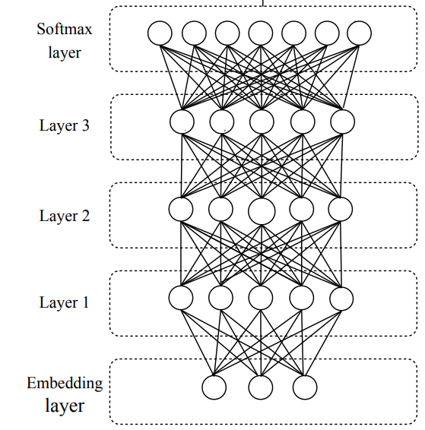
1. Background: traditional NLP vs Pre-trained Language Models
1) Traditional Neural Network
Disadvantages
Training is slow and computationally expensive.
Long sequences cause vanishing gradients, leading to loss of word relationships
Advantages
Fine-tune a Language model
2) Pre-trained large language model
Pre-trained models drastically reduce training time.

Slide 8
1. Methodology (Prior): BioBert Fine-tuning
BioBERT = Pre-trained BERT + Additional pre-training on biomedical data
BioBert model pre-trained with PubMed
Bert
325 structured product tables
(Pre-specified by TAC2019)
PubMed abstracts
PMC full-text articles
21593 annotated sentences
Fine-Tuning
Model Training
13B words
BioBert Directional DDI model¹
BioBert 340M parameters
81 structured Product labels
(Pre-specified by TAC2019)
10592 unannotated sentences
Predict precipitant and object drugs in pharmacokinetic DDIs
Model Validation
Relationship Extract (RE)
Named Entry Recognition (NER)
QA
Evaluate Performance
Zirkle, Joel, et al. "Deep learning-enabled natural language processing to identify directional pharmacokinetic drug–drug interactions." BMC bioinformatics 24.1 (2023): 413.

Slide 9
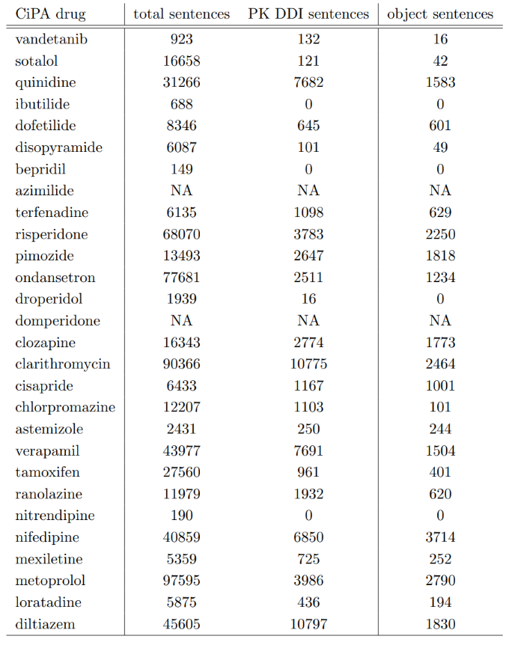
1. Result (Prior): BioBert Directional DDI Model (fine-tuned BioBERT)
1st task: PK-DDI Identification Task
Real world problem
From a list of 28 drugs from the Comprehensive in vitro Proarrhythmia Assay (CiPA) Initiative.
Recall | 80.6 %
Precision | 82.7%
F-score | 81.6%
Performance of the sentence classification step.
2nd task: Identifying Object and Precipitant drugs in PK DDI sentences
 | Object | Precipitant
Recall | 93.7% | 94.6%
Precision | 100% | 100%
F-score | 96.8% | 97.2%
Performance of the named entity recognition step
Zirkle, Joel, et al. "Deep learning-enabled natural language processing to identify directional pharmacokinetic drug–drug interactions." BMC bioinformatics 24.1 (2023): 413.

Slide 10
2. Second study: Using LLM to extract clin pharm information with few/zero training
Objective: Fine-tuning a pre-trained model for a new task is impossible unless we acquire an annotated dataset containing positive and negative examples related to the specific task.

Slide 11
2. Second study: Using LLM to extract clin pharm information with few/zero training
Objective: Fine-tuning a pre-trained model for a new task is impossible unless we acquire an annotated dataset containing positive and negative examples related to the specific task.
Goal:
Extract critical biomedical data, such as pharmacokinetic drug-drug interactions, precipitant -object drug, and intrinsic factors and so on, from literature using locally hosted Large Language Models (LLMs).
Ensure data privacy to Implement secure locally hosted Large Language Models.

Slide 12







2. Pre-trained Transformer-based Large Language Model
ChatGPT
Google Bard
Chat Sonic
Perplexity AI
Jasper AI
Claude
Objectives
One can use our previous technique, HOWEVER, for any task we need to prepare sufficiently large training/validation dataset and consequently fine-tun the model
One can use one of these online sources, HOWEVER, there is a risk of data leakage associated with the utilization of online platforms
Implement secure, locally hosted Large Language Models to automate extraction and classification of interaction data while ensuring data privacy

Slide 13
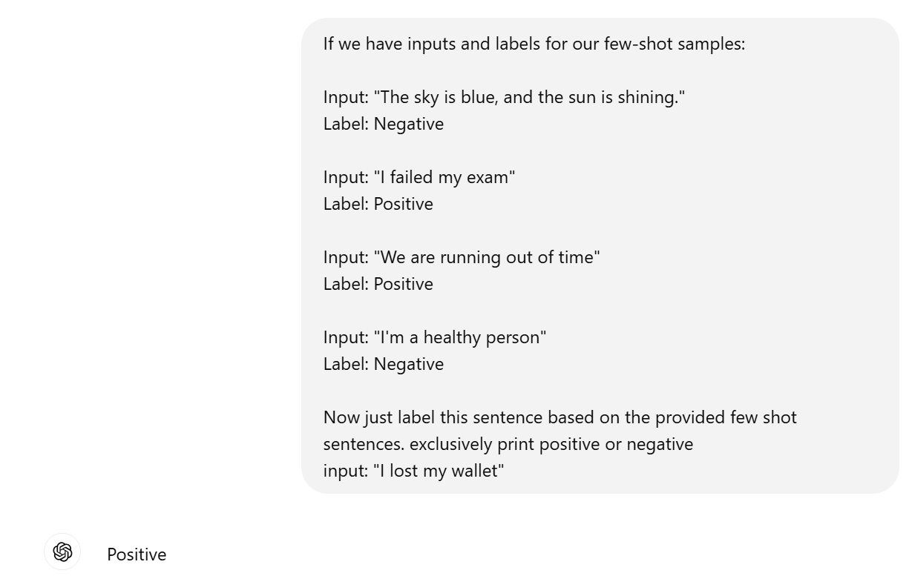


2.In-context learning: Few/Zero shot training
Using Few-Shot learning to train ChatGBT
FSL
Large data collection
Example 1: PK DDI sentence Example 2: PK DDI sentence
Example 3: Non-PK DDI sentence Example 4: Non-PK DDI sentence
+
Prompt + (sentences set)
FSL input
Query set Prediction
Pre-processing
Model Inference
Tokenization
Post-Processing
Few-shot learning (FSL) practice of feeding a machine learning model with a very small amount of training data to guide its predictions

Slide 14
2.In-context learning: Few/Zero shot training
FSL
Large data collection
Example 1: PK DDI sentence Example 2: PK DDI sentence
Example 3: Non-PK DDI sentence Example 4: Non-PK DDI sentence
+
Prompt + (sentences set)
FSL input
Query set Prediction
Pre-processing
Model Inference
Tokenization
Post-Processing
Few-shot learning (FSL) practice of feeding a machine learning model with a very small amount of training data to guide its predictions

Slide 15
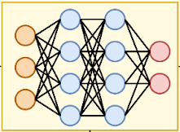

2.In-context learning: Few/Zero shot training
Transformer Model
Flan-T5-XXL
Tk-instruct
T0PP
Vicuna
BioBert
Large Labeled Dataset
Large language transformer Models
Zero-shot learning
Query set Prediction
Prompt Query + (sentences set)
Pre-processing
Hugging Face
Model Inference
Tokenization
Post-Processing
Zero-shot learning (ZSL) is a Machine Learning paradigm that introduces the idea of Query samples with class labels that were never observed during the initial training phase
11

Slide 16
2. Pre-trained Large Language Transformer Models
Model | Parameter size | Trained source | Strengths | Weaknesses
Tk-Instruct | 11B | Dataset of text and code from a variety of sources, including books, articles, code repositories, and conversations. | Following instructions, completing requests thoughtfully | Can be slow and computationally expensive
Flan-T5-XXL | 11B | Massive dataset of text and code, including books, articles, code repositories, and conversations. | General-purpose LLT, good at tasks that require general knowledge | Can be slow and computationally expensive
T0pp | 11B | Dataset of text and code from a variety of sources, including books, articles, code repositories, and social media. | Text classification, sentiment analysis, question answering | Not as good at tasks that require following instructions as Tk-Instruct
Vicuna | 13B | Dataset of code from GitHub | Code generation, understanding and translating code | Not as good at general-purpose NLP tasks as Flan-T5-XXL
ChatGPT3 | 175B | Dataset of text and code from a variety of sources, including books, articles, code repositories, and conversations. | Conversational AI, chatbots | Can be less informative than other LLT models
BioBERT | 0.34B | Dataset of biomedical text, including clinical notes, research papers, and drug labels. | Biomedical NLP tasks such as clinical text processing and drug discovery | Not as good at general-purpose NLP tasks as other LLT models

Slide 17
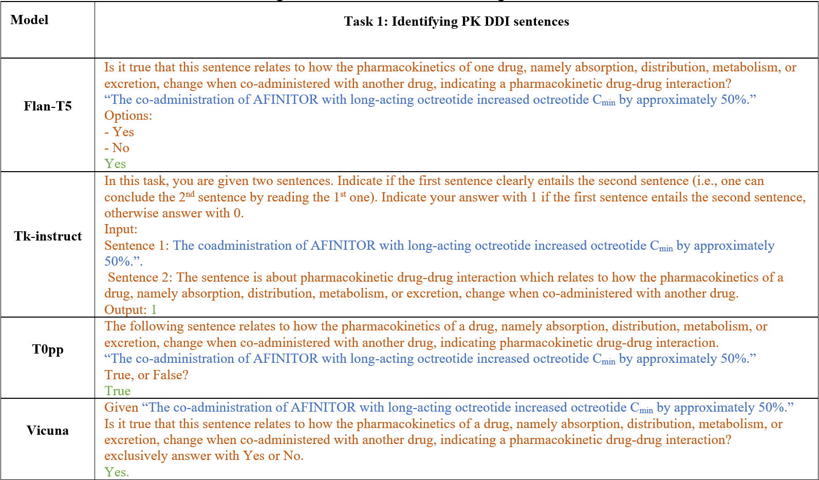
2. Prompt Question: PK-DDI

Slide 18
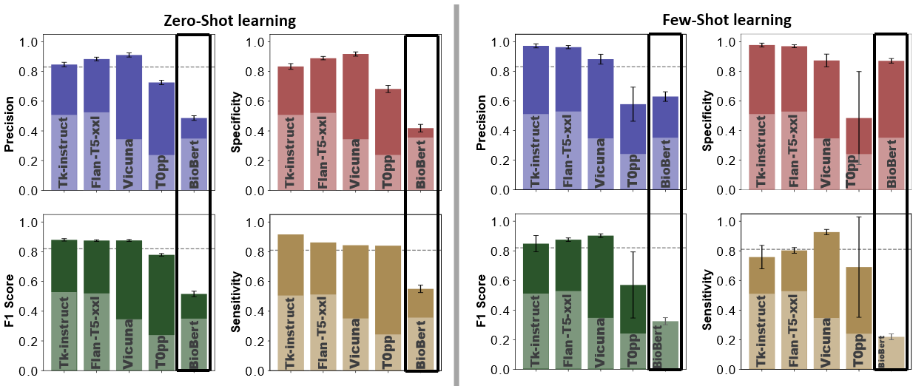
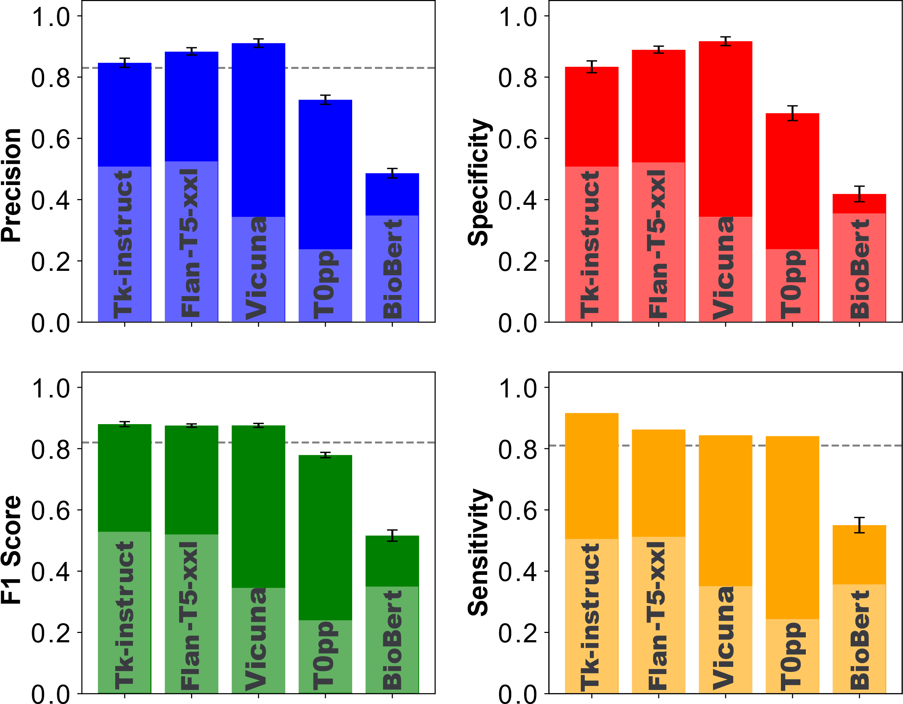
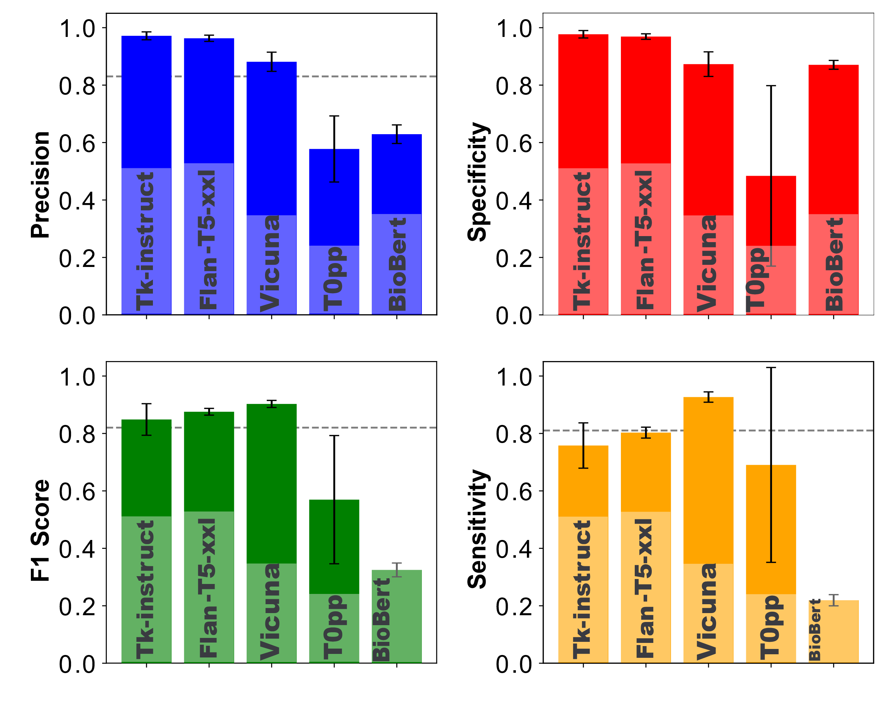
2. Model Evaluation: Validate LLMs performance by identifying PK-DDI sentences to compare it with the prior project
Prior study
second study
Fine-tuned BioBert evaluated through 10592 sentences
Zero / Few-shot learning evaluated by 10242 (PK and Non-Pk DDI) sentences
Fine-tuned BioBert model
Zero-Shot learning
Few-Shot learning

Slide 19
2. Evaluate LLM performance on a new task
Prior study
“Because substances in grapefruit juice may inhibit the metabolism of Pimozide by CYP3A4, patients should be advised to avoid grapefruit juice.” [1]
Object?
Grapefruit juice is precipitant and Pimozide is the object drug
“Verapamil therapy may increase serum levels of cyclosporine.” [1]
Verapamil is precipitant and Cyclosporine is the object drug
Precipitant?
2nd Task: Identifying intrinsic factors, such as age, gender, genetics, additional disease and organ function, that may alter clinical exposure
“Following a single 20mg oral Zolpidem tartrate dose, mean Cmax and AUC were found to be two times and five times higher, respectively, in hepatically-compromised patients.” [1]
Zolpidem's clinical exposure have been impacted by Intrinsic factors of liver diseases.
Intrinsic factors?
[1] https://dailymed.nlm.nih.gov/dailymed/fda

Slide 20
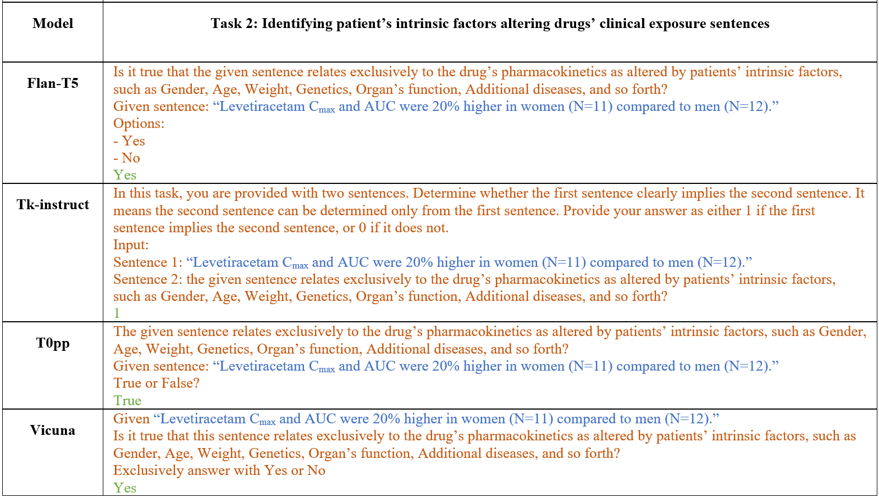
2. Prompt Questions: Intrinsic factors affecting drug clinical exposure

Slide 21
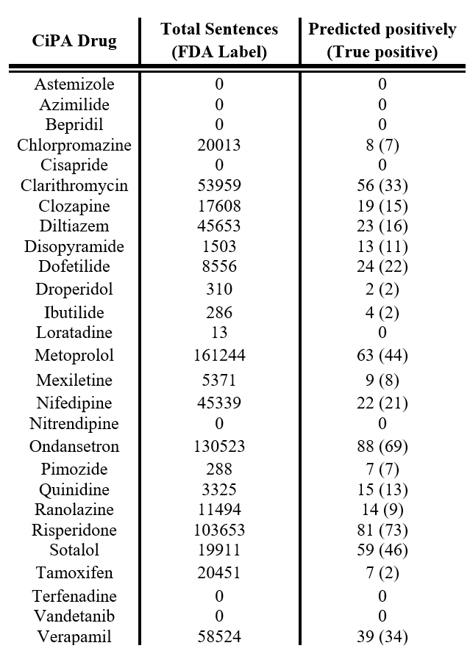
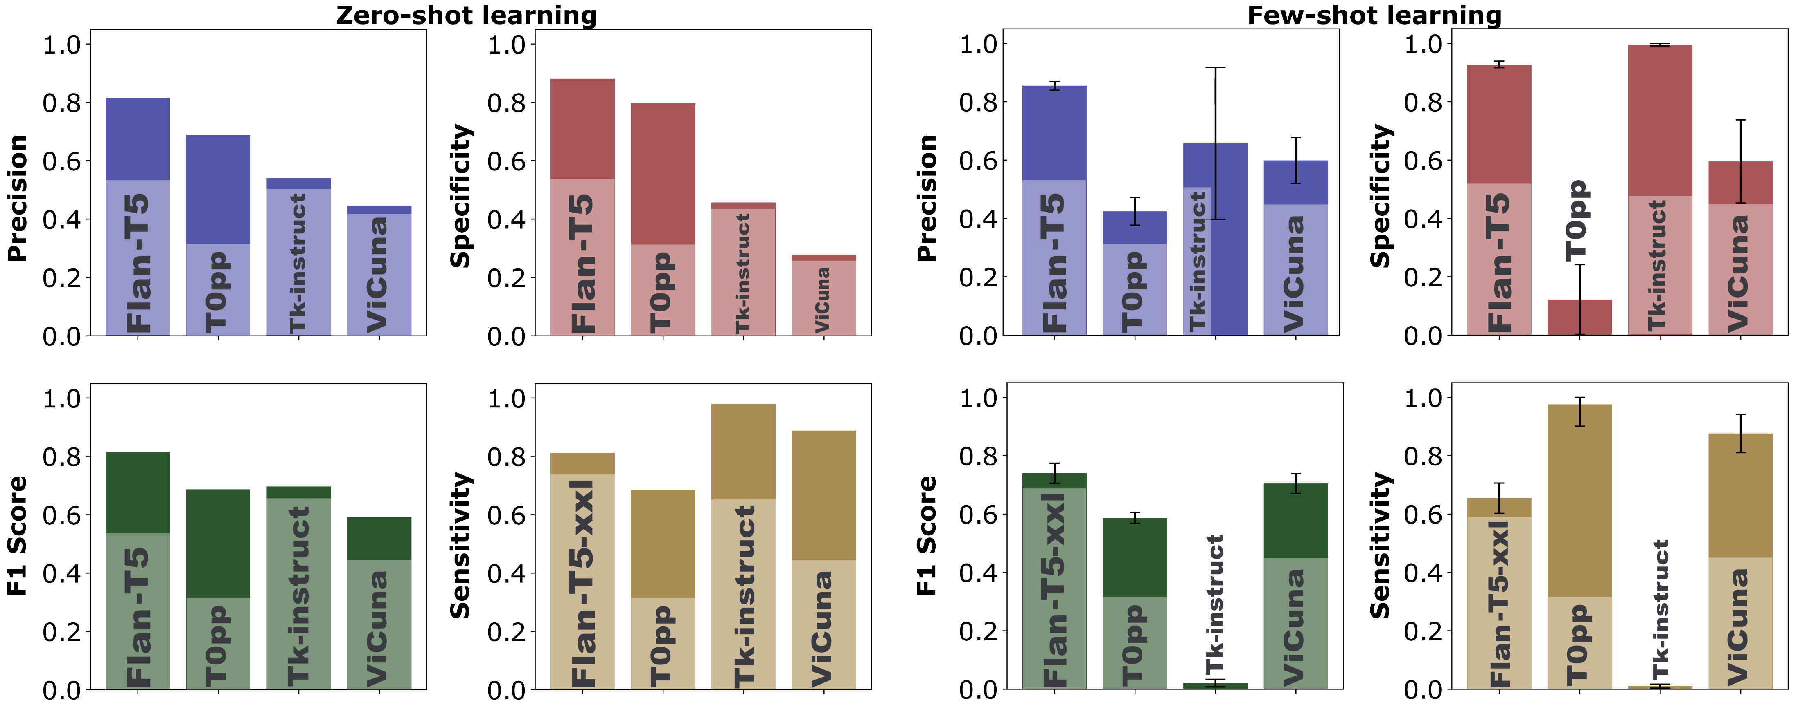
2. Model Evaluation: Intrinsic factors affecting drug clinical exposure
Real world problem
Zero and Few-shot learning evaluated by 500 sentences For sentence classification task focused on intrinsic factors that affect drug clinical exposure (198 positive and 302 negative sentences)
From a list of 28 drugs from the Comprehensive in vitro Proarrhythmia Assay (CiPA) Initiative. 708,024 sentences being extracted from the labels
precision rate 78.5%

Slide 22
Summary
Prior Study
For any task such as identify the clinical exposure, change due to PK DDI from a sentence there are naturally three steps:
Obtain annotated dataset to fine-tune the pre-trained language model.
Identify sentences that carry DDI information in the PK category.
Identify the precipitant and objects drugs in those sentences.
Second Study
Using large language model make it feasible to extract clinical pharmacology information.
We first test it by extracting PK-DDI sentences using four well known LLMs (Tk-Instruct, Vicuna, T0pp, and Flan-T5-XXL)
Apply a randomly new task (patients' intrinsic factors) without fine-tuning.
Both zero-shot and few-shot learning provided excellent performance.
These models stand out because they don’t require fine-tuning, making them easier to implement compared to the fine-tuned BioBERT model.
Our results demonstrate the feasibility of implementing a ChatGPT-like model within the FDA network with secure local deployment.
Future Work
LLM Image Processing Capabilities
User-Friendly Interfaces
Real-Time Adaptation

Slide 23

Acknowledgment
DARS Mechanistic Modeling Team
Zhihua Li
John Mann
Joel Zirkle
Shilpa Chakravartula
Anik Chaturbedi
Ghazal Arabidarrehdor

Slide 24
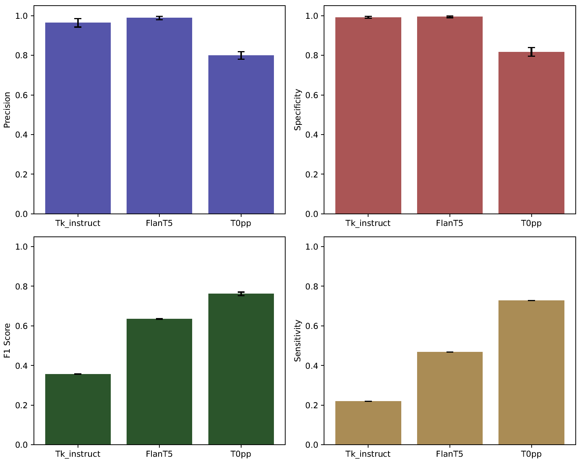



Zero-Shot learning comparing intrinsic factors by
Flan-T5-XXL & Tk-Instruct & T0pp
Tk-instruct
In this task, you are given two sentences. Indicate if the first sentence clearly entails the second sentence (i.e., one can conclude the 2nd sentence by reading the 1st one). Indicate your answer with 1 if the first sentence entails the second sentence, otherwise answer with 0
Input: Sentence 1: Evaluation Sentences
Sentence 2: This sentence is addressing or pertaining to pharmacokinetic associated with intrinsic factors .
Output: ?
Zero-Shot Learning
Precision
Specificity
T0pp
Given: Evaluation Sentences
This sentence addressing or pertaining to the pharmacokinetic properties associated with intrinsic factors. is this true?
Yes or no?
Flan-T5-xxl
Evaluation Sentences. Is this statement specifically addressing or pertaining to the pharmacokinetic properties associated with intrinsic factors?
Options:
- Yes
- No
F1 Score
Sensitivity

